Slide 1
L6_Projection of Line 1
B. SANTHI
Assistant t Professor
Department of MECHANICAL Engineering
NIT Goa

Slide 2
Line
Locus of a point that moves linearly
The shortest distance between two points is called a straight line
The projectors of a straight line are drawn therefore by joining the projections of its end points
Description of line is through reference planes
Horizontal plane (HP)
Vertical plane (VP)
Profile plane (PP) in terms of words --- in front, Behind, Above, Below)
The possible projections of straight lines with respect to V.P and H.P in the first quadrant are as follows:
I. Perpendicular to one plane and parallel to the other.
2. Parallel to both the planes.
3. Parallel to one plane and inclined to the other.
4. Inclined to both the planes.

Slide 3
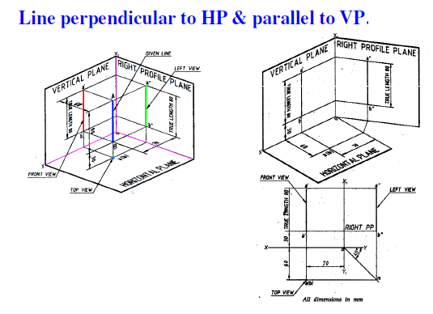
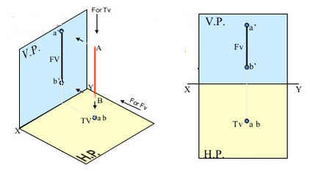

Slide 4
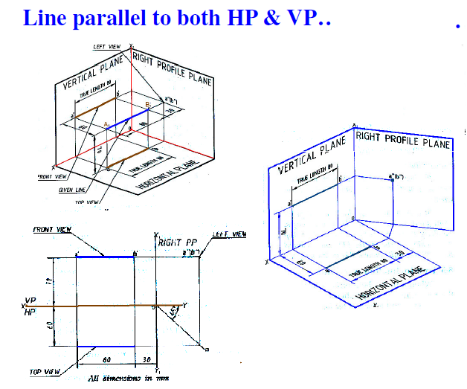
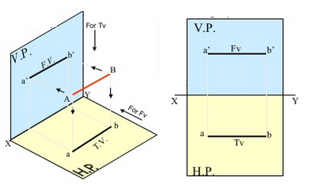

Slide 5
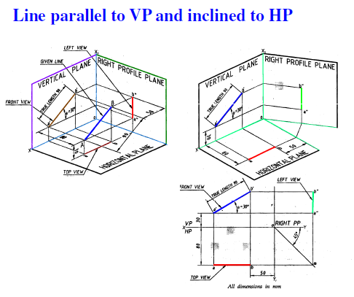
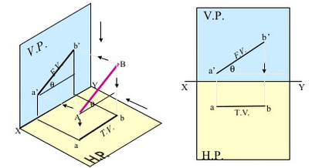

Slide 6
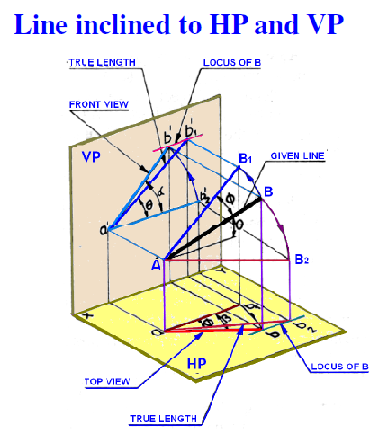
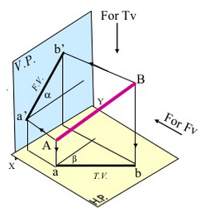

Slide 7
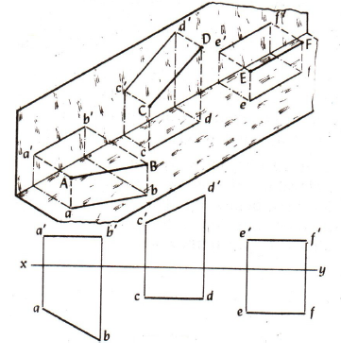
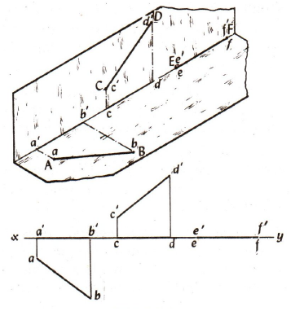
Line parallel to one or both planes
Line on a plane

Slide 8
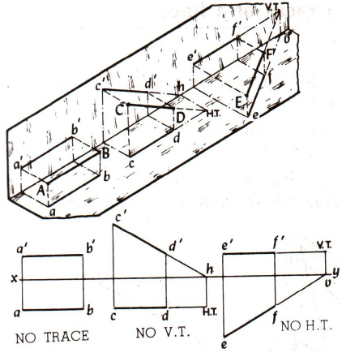
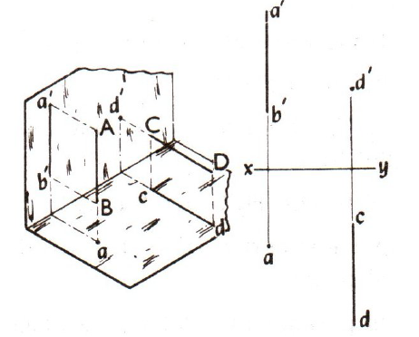
Line perpendicular to one of the planes
Line is parallel to any one plane

Slide 9
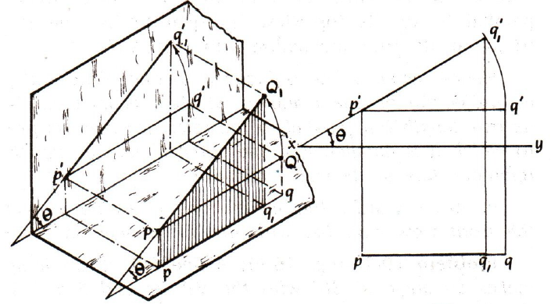
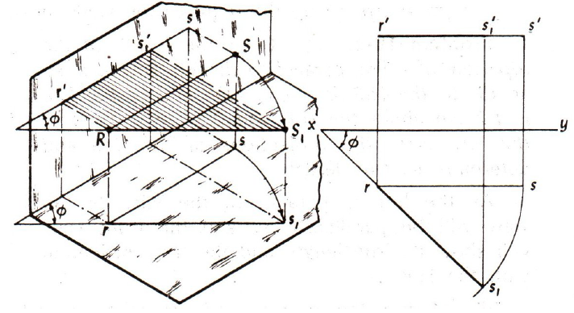
Line inclined to HP
& parallel to VP
Line parallel to HP
& inclined to VP

Slide 10
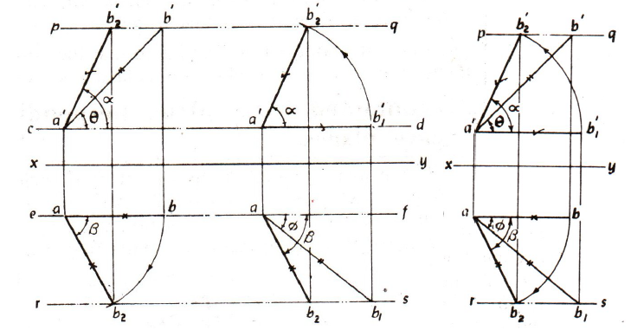
Line making inclination with HP & with VP

Slide 11
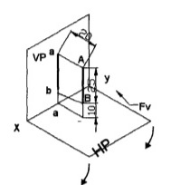
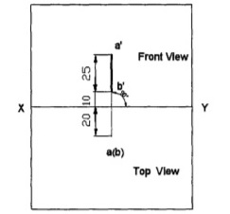
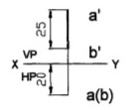
Line perpendicular to H.P and parallel to V.P
True length of AB = a’ b’

Slide 12
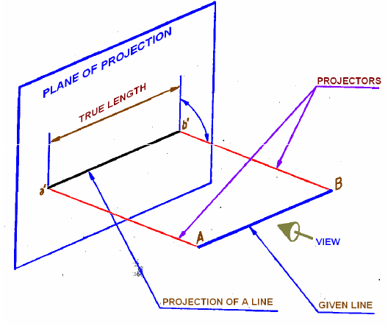
True length and Apparent length
When the line is inclined to HP and parallel VP, the length of the line in the front view line is known as true length of the line and the shorter length of the line in the TV is known as apparent length.
When the line is parallel to HP and VP, the true length of the line is same in both views.
When the line is Perpendicular to HP and parallel to the VP, the true length of the line appears in FV.
When the line is inclined to both the HP and the VP, the length of the length of the line in the front view as well as in the TV will be shorter than the actual length of the line. The shorter length of the line in the FV as well as in the TV is known as apparent length of the line while the actual length of the line is known as true length of the line.

Slide 13
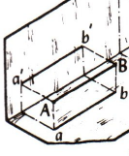
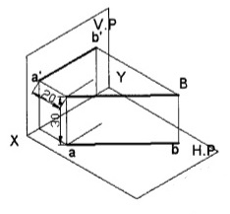
True Length AB
Line is parallel to one reference plane => True length = Length of the View
If Line is inclined to one reference plane => True length > Apparent length
Apparent Angle
Line is inclined to one reference plane => True inclination < Apparent angle

Slide 14
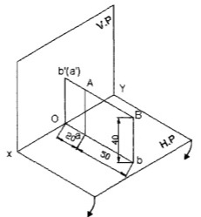
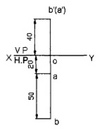
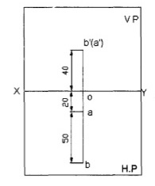
Line perpendicular to V.P and parallel to H.P.
A line AB 50 mm long is perpendicular to V.P and parallel to H.P. Its end A is 20 mm in front of V.P. and the line is 40 mm above HP. Draw the projections of the line.
The line is parallel to H.P. Therefore the true length of the line is seen in the top view. So, top view is drawn fIrst.

Slide 15
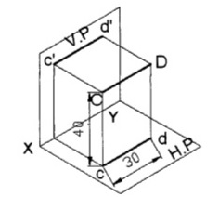
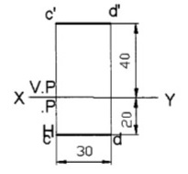
Line parallel to both the planes
A line CD 30 mm long is parallel to both the planes. The line is 40 mm above HP and 20 mm in front of V.P. Draw its projection

Slide 16
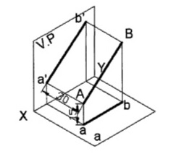
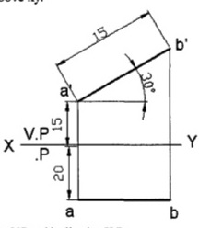
Line parallel to V.P and inclined to H.P.
A line AB 40 mm long is parallel to v.p and inclined at an angle of 30⁰ to HP. The end A is 15 mm above HP and 20 mm in front of v.P. Draw the projections of the line.
Note: 1. Inclination of line with the H.P is always denoted as Ө.
2. When a line is parallel to V.P. and inclined at an angle Ө to H.P, this inclination is seen in the front view and Ө indicates always the true inclination with H.P. Hence, front view is drawn fIrst to get the true length of the line.

Slide 17
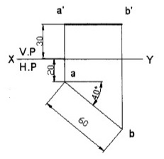
Line parallel to H.P and inclined to V.P.
Draw the projections of straight line AB 60 mm long parallel to HP and inclined at an angle of 40⁰ to V.P. The end A is 30 mm above HP. and 20 mm in front of V.P.
Note: 1. Inclination of a line with V.P is always denoted by ᶲ.
2. when a line is parallel to H.P and inclined at an angle of ᶲ to v.P, this inclination ᶲ is seen in the top view and hence top view is drawn fIrst to get the true length of the line.

Slide 18
Thank You

